Slide 1
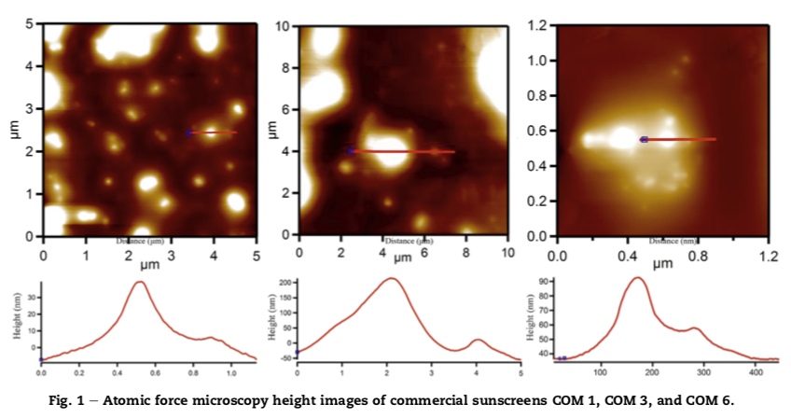
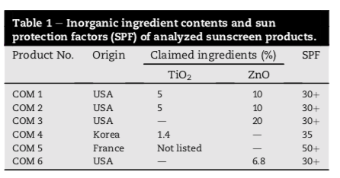
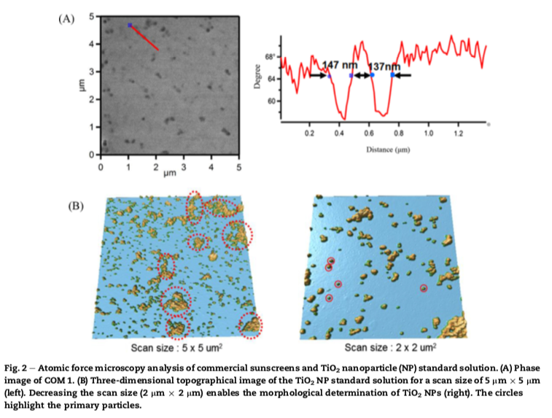
Analysis of titanium dioxide and zinc oxide nanoparticles in cosmetics
Aim
To assess the effectiveness of these methods in characterizing NP-based cosmetics.
Samples
Six commercial sunscreens with inorganic NPs in their formulation.
Standard solutions of TiO2 (107 nm) and ZnO NPs (76 nm) used as control samples
Results
Process
The AFM height images of the NPs in sunscreen samples displayed unobvious contours (Fig. 1) because the NPs were embedded in the soft cosmetic formulation, precluding NP size measurement. Therefore, a phase analysis was performed to distinguish different components from the sunscreen matrix. The phase image of COM 1 presented clearer NP features than height images (Fig. 2A). By contrast, the 5 mm x 5 mm topographic image of the TiO2 NP standard solution showed some aggregates (Fig. 2B). TiO2 NP sizes ranging from 14.4 nm to 27 nm were measured in the standard solution for a 2 mm x 2 mm scan area.
AFM
Equipment: Asylum Research MFP- 3D system (Goleta, CA, USA) in tapping mode.
Scann areas: 90 µm x 90 µm.
The cantilever and samples were located using a charge-couple device monitor. Unmodified sunscreens were transferred onto a glass slide, flatted with a glass coverslip, and air-dried. Size-related sample imaging was conducted at 10 mm, 5 mm, 2 mm, and 1.2 mm scan widths. Acquired phase and height images were analyzed using Asylum Research IGOR PRO-based software
Pei-Jai Lu et al. Journal of food and drug analysis 23 (2015) 587-594

